Slide 1
數據整理和準備
人工智慧與資訊安全
學生:4060D003 陳宥彣
指導教授:龍大大

Slide 2
Agenda
資料程式
資料顯示結果

Slide 3
資料程式
from numpy import nan as NA data = pd.Series([1, NA, 3.5, NA, 7]) data.dropna()
In [ ]:
data[data.notnull()]
In [ ]:
data = pd.DataFrame([[1., 6.5, 3.], [1., NA, NA], [NA, NA, NA], [NA, 6.5, 3.]]) cleaned = data.dropna() data cleaned
In [ ]:
data.dropna(how='all')
In [ ]:
data[4] = NA data data.dropna(axis=1, how='all')
In [ ]:
df = pd.DataFrame(np.random.randn(7, 3)) df.iloc[:4, 1] = NA df.iloc[:2, 2] = NA df df.dropna() df.dropna(thresh=2)

Slide 4
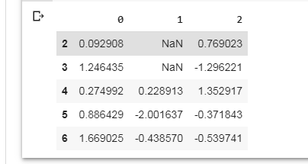
資料顯示結果

